Slide 1

CIT-2180 Data and Database Management Chapter 10

Slide 2

Oracle 12C: SQL
Chapter 10
Selected Single-Row Functions

Slide 3
Terminology
Function – predefined block of code that accepts arguments
Single-row function – returns one row of results for each record processed
Multiple-row function – returns one result per group of data processed (covered in the next chapter)

Slide 4
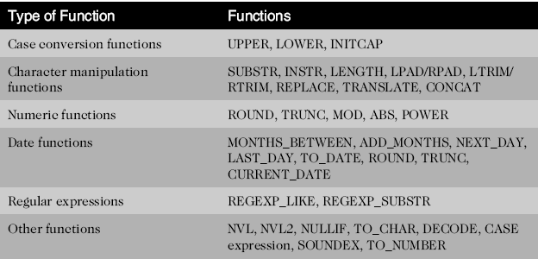
Types of Functions

Slide 5
Case Conversion Functions
Case conversion functions alter the case of data stored in a column or character string
Used in a SELECT clause, they alter the appearance of the data in the results
Used in a WHERE clause, they alter the value for comparison

Slide 6
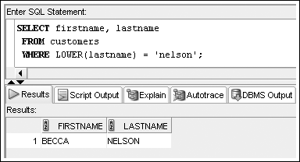
LOWER Function
LOWER (c)
Where c is the character string to be converted into lowercase

Slide 7
UPPER and INITCAP Function
To affect the display of characters, it is used in a SELECT clause
To modify the case of characters for a search condition, it is used in a WHERE clause
The syntax for the UPPER (c) function is
Where c is the character string or field to be converted into uppercase characters
The syntax for the INITCAP (c) function is
Where c is the character string or field to be converted into mixed case characters

Slide 8
Character Manipulation Functions
Character manipulation functions manipulate data by extracting substrings, counting the number of characters, replacing strings, etc.

Slide 9
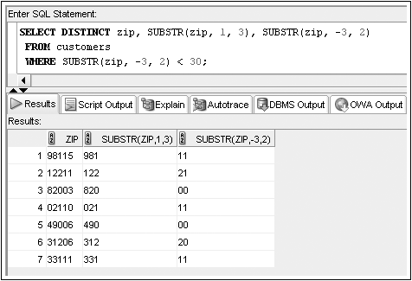
SUBSTR Function
SUBSTR (c, p, l)
c is the character string to be extracted
p is the position (beginning) for the extraction
l is the length of the resulting string

Slide 10
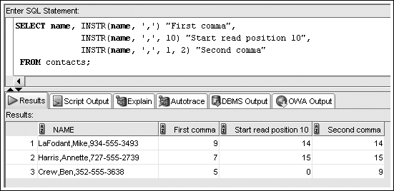
INSTR Function
INSTR (c, s, p, o)
c is the character string to be searched
s is the search string
p is the starting position for the search
o is the occurrence of the search string to identify

Slide 11
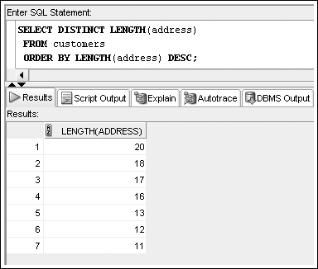
LENGTH Function
LENGTH (c)
c is the character string whose length is to be determined

Slide 12
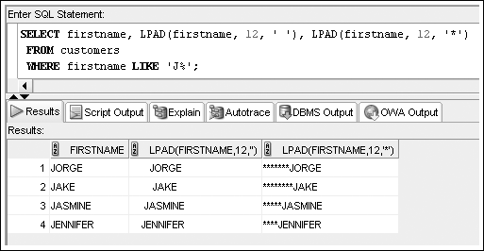
LPAD and RPAD Functions
LPAD (c, l, s) RPAD (c, l, s)
c is the character string to be padded
l is the length of the new string after padding
s is the symbol or character used in the padding

Slide 13
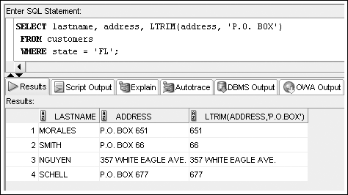
LTRIM and RTRIM Functions
LTRIM (c, s) RTRIM (c, s)
c is the character string to be trimmed
s is the string to be trimmed (from left or right)

Slide 14
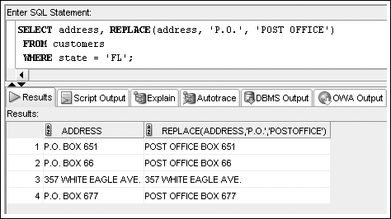
REPLACE Function
REPLACE (c, s, r)
c is the character string to be padded
s is the string of characters to find
r is the string of characters to substitute for s

Slide 15
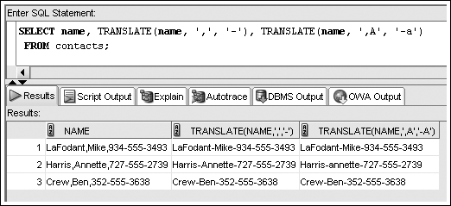
TRANSLATE Function
TRANSLATE (c, s, r)
c is the character string to search
s is the search character
r is the substitution character

Slide 16
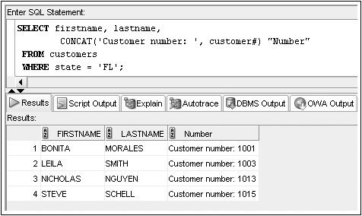
CONCAT Function
CONCAT (s1, s2)
s1 is the first string
s2 is the second string, to be concatenated with the first

Slide 17
Number Functions
Allow for manipulation of numeric data
ROUND
TRUNC
MOD
ABS

Slide 18
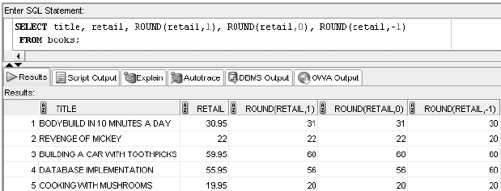
ROUND Function
ROUND (n, p)
n is the number to be rounded
p is the position to round (+ is right of decimal, - is left of decimal)

Slide 19
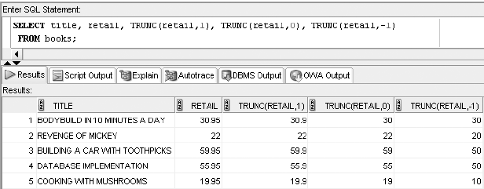
TRUNC Function
TRUNC (n, p)
n is the number to be truncated
p is the position to round (+ is right of decimal, - is left of decimal)

Slide 20
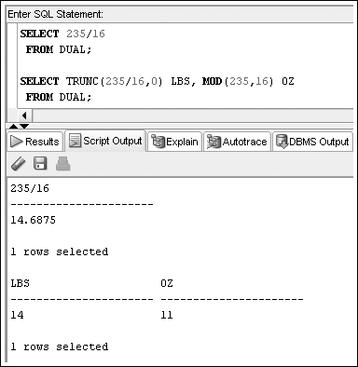
MOD Function
MOD (n, d) - find the remainder of n / d
n is the numerator
p is the denominator

Slide 21
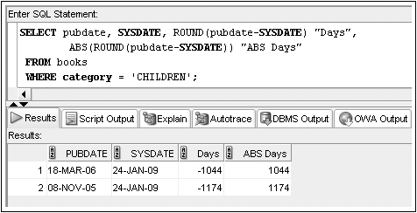
ABS Function
ABS (n) - find the absolute value
n is the number

Slide 22
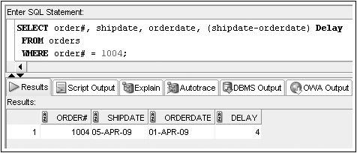
Date Functions
Perform date calculations or format date values
Subtract date for number of days difference

Slide 23
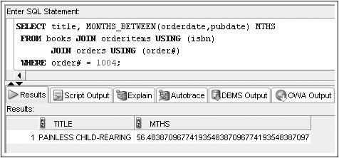
MONTHS_BETWEEN Function
MONTHS_BETWEEN (d1, d2)
d1 is first date
d2 is second date, subtracted from d1

Slide 24
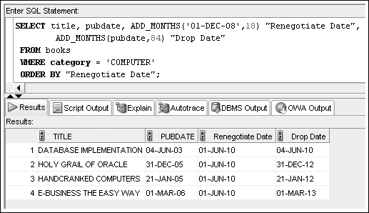
ADD_MONTHS Function
ADD_MONTHS (d, m)
d is beginning date
m is the number of months to add to the date

Slide 25
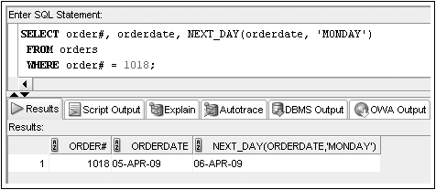
NEXT_DAY Function
NEXT_DAY (d, DAY)
d is date
DAY is the day of week identified (e.g. ‘MONDAY’)

Slide 26
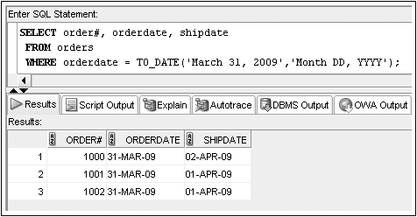
TO_DATE Function
TO_DATE (d, ‘f’)
d is the date string to be converted to date data type
f is the format (see table 10-4 page 366 – 367)

Slide 27
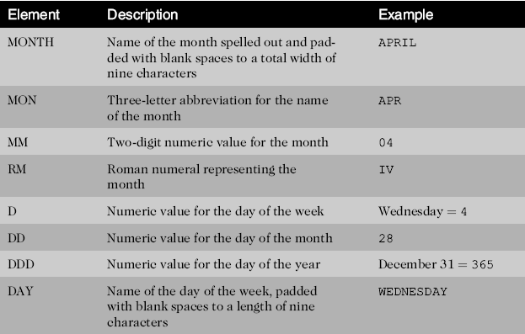
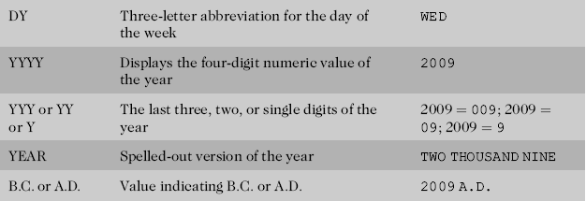
Format Model Elements - Dates

Slide 28
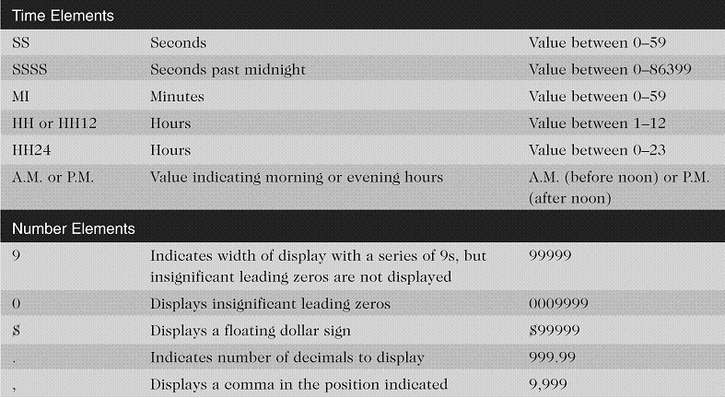
Format Model Elements – Time and Number

Slide 29
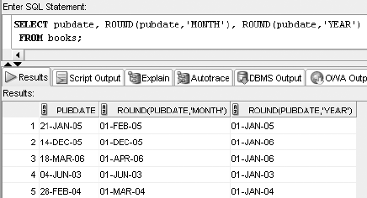
ROUND() on dates

Slide 30
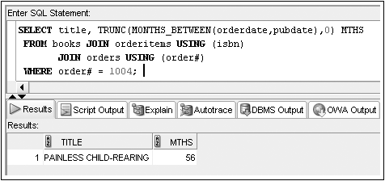
TRUNC() on dates

Slide 31
Other Functions
NVL
NVL2
TO_CHAR
DECODE
SOUNDEX

Slide 32
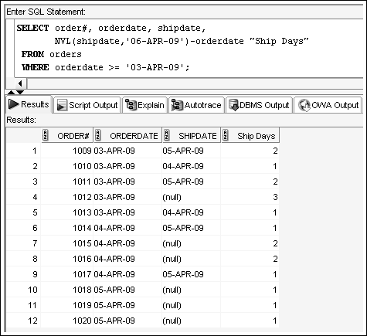
NVL Function
NVL (x, y) (see also NVL2(), NULLIF())
x is value to be tested for NULL
y is the substituted value IF x IS NULL

Slide 33
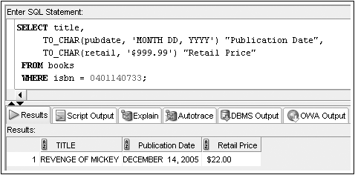
TO_CHAR Function
TO_CHAR (n, ‘f’)
n is the number or date to be converted to a string
f is the format (see table 10-4 page 366 – 367)

Slide 34
Oracle 12C: SQL
END OF Chapter 10
Selected Single-Row Functions

